Slide 1
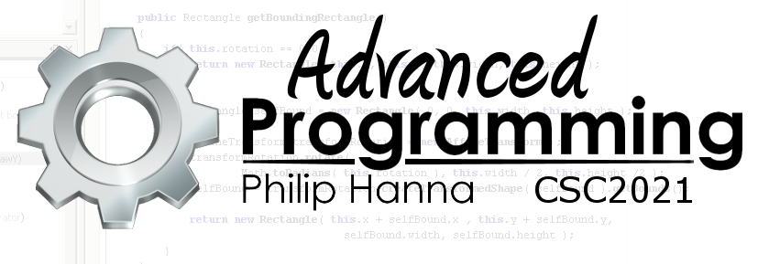
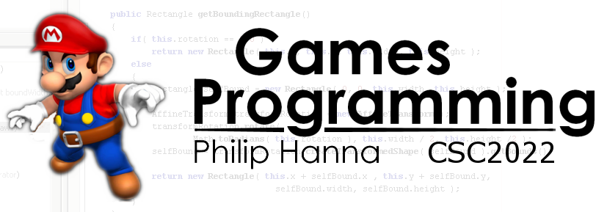
Pointers
All things pointer related
Part 1 - Introduction

Slide 2

Pointers

Slide 3
Reminder: variables can be defined in terms of:
Given the statement
1 | int a = 4;
Stored value
Start address in memory
Number of reserved bytes
Variable
The compiler will set aside four-bytes of memory at an address that is uniquely associated with the variable a and initially populate those four bytes with the binary encoding of the integer 4.
Notes:
Reminder: variables can be defined in terms of:
the value stored in the variable
the number of bytes reserved for the variable
the start location in memory for the variable
Given the statement
int a = 3;
The compiler will set aside four-bytes of memory at an address that is uniquely associated with the variable ‘a’ and initially populate those four bytes with the binary encoding of the integer 2.

Slide 4
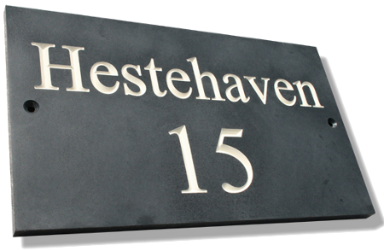
The C++ address operator (&) permits the location of any variable to be determined. Hence &a is the address of variable a in memory.
A pointer is defined as the memory address of a variable. A pointer value can be stored in what is known as a pointer variable (or just a pointer for short).
Notes:
The C++ address operator (&) permits the location of any variable to be determined. Hence &a is the address of variable a in memory
A pointer is strictly defined as the memory address of a variable.
A pointer value can be stored in a variable. Such a variable must be declared to as capable of holding a pointer. It is also known as a pointer variable (or just a pointer for short).

Slide 5
A pointer variable to a value of type T is defined as shown:
1 | T varName; // define variable
2 | T *ptrName; // define pointer
3 | ptrName = &varName; // assign address
A pointer points to an address in memory. The pointer needs an associated type to know what it is pointing to (and how to interpret memory at that location).
int*
4 bytes / interpreted as an int
float*
4 bytes / interpreted as a float
double*
8 bytes / interpreted as a double
Notes:
A pointer variable to a value of type T is defined as follows:
T varName
T *ptrName;
ptrName = &varName;
A pointer points to an address in memory. The pointer needs an associated type to know what it is pointing to (and hence how to interpret memory at that location).

Slide 6

Address | Value
0x1000 | 56
0x1001 | 00
0x1002 | 00
0x1003 | 00
0x1004 | 00
0x1005 | 10
0x1006 | 00
0x1007 | 00
0x1008 | 00
0x1009 | 00
0x1010 | 00
0x1011 | 00
The code fragment below would be realised in memory as shown:
Storage of data
Points to memory address of data
1 | int data = 0x56;
2 | int *ptrData = &data;
Storage of ptrData
Aside: Typically in a 32 bit system pointers are 4 bytes in size and 8 bytes in a 64-bit system.

Slide 7

In order to access the contents at a stored address, C++ uses an indirection operator or dereferencing operator (the * symbol). Hence if ptrNum is a pointer to an integer, then *ptrNum means the value of the variable pointed to by ptrNum
The following have the same functional output:
1 | int add(int num1, int num2)
2 | {
3 | return num1 + num2;
4 | }
5 | add(someInt, otherInt);
1 | int add(int* num1, int* num2)
2 | {
3 | return *num1 + *num2;
4 | }
5 | add(&someInt, &otherInt);
Obviously, the version without pointers is ‘cleaner’.
Notes:
In order to access the contents at a stored address C++ uses an indirection operator or dereferencing operator ( the ‘*’ symbol). Hence if ptrNum is a pointer to a integer, then *ptrNum means the variable pointed to by ptrNum
The following have the same functional output:
int add(int num1, int num2)
{
return num1 + num2;
}
add(someInt, otherInt);
int add(int* ptrNum1, int* ptrNum2)
{
return *ptrNum1 + *ptrNum2;
}
add(&someInt, &otherInt);
Obviously the first is cleaner
Aside: Yes, the indirection operator is the same as the multiplication operator – the context is used to determine the intended usage.

Slide 8

Why Use Pointers?
Using a pointer requires a double lookup – first retrieving the address value stored in memory and then using the retrieved address to retrieve the actual data.
Why incur this cost? Why use pointers? For two reasons:
The fundamental (and powerful) relationship between pointers and arrays
The ability to create and delete dynamically allocated storage at runtime.
Notes:
Why are pointers useful?
Using a pointer requires the computer to do a double lookup – first retrieving the address value stored in memory and then using the retrieved address to receive the actual data.
Given the double lookup why are pointers useful? Why incur the cost of a double lookup?
There are two reasons (both of which will explored):
The fundamental (and powerful) relationship between pointers and arrays
The ability to create and delete dynamically allocated storage at runtime.

Slide 9

When passing pointers to a function, the following style is commonly used:
But, when declaring a variable of some pointer, it is common to use the following style:
There can be a space before/after the type or variable name. The above conventions are recommended as they clearly show what is intended. The following are valid but potentially confusing:
1 | void foo(int* ptrInt)
1 | int *ptrInt1, *ptrInt2;
AND USE
GOOD POINTER
1 | int* a, b; // a is a pointer, b isn’t
2 | int* a, *b; // a and b are pointers
Notes:
When passing pointers into a function it is common to use the following style:
void foo(int* ptrInt);
But when declaring a variable of some pointer, it is common to use the following sytle:
int *ptrInt1, *ptrInt2;
The C++ compiler does not mind if there is a space before/after the type or variable name. The above conventions are recommended as they clearly show what is intended.
The following are valid but potentially dangerously in terms of being confusing:
int* a, b; // a is a pointer to an int, b is an int (not a pointer)
int* a, *b; // both a and b are pointers to int’s

Slide 10

Code should be written so that the meaning is apparent in the eye of the beholder.

Slide 11

Key takeaways:
Pointers are wonderfully powerful.
They provide a flexible means of manipulating data stored in memory.
Although, with great power comes great responsibility. Care should be taken to ensure safe pointer usage.
In particular, code should be written so that the meaning is apparent in the eye of the beholder.

